Slide 1

DATA 606:
Capstone in Data Science (PHASE-2 Presentation)
Portfolio Risk Analysis
Group Members:
Chirag Jadav
Harshil Prajapati

Slide 2
Problems Faced in Phase-1
Problem-1: Handling NaN values.
Problem-2: Need to make changes based on percentage(%) change.
Problem-3: Perform EDA on Balancing portfolio by assigning weights.

Slide 3
How we overcome those problems
Dropping NaN values for the dates if any stocks was introduced in the market after the selected start date.
Imputing NaN values with either mean, mode, interpolation results to a biased distribution of data which can lead to incorrect risk assessment.
It was difficult to track the return and volatility with the changes in stock price value, so we implemented the % change to track it.

Slide 4
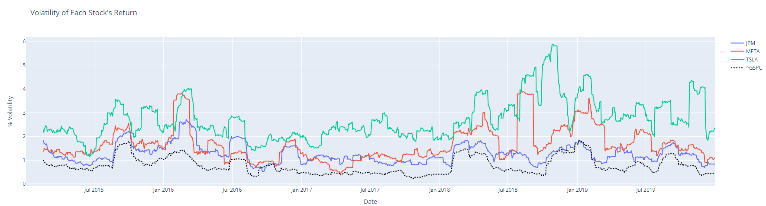
Volatility

Slide 5
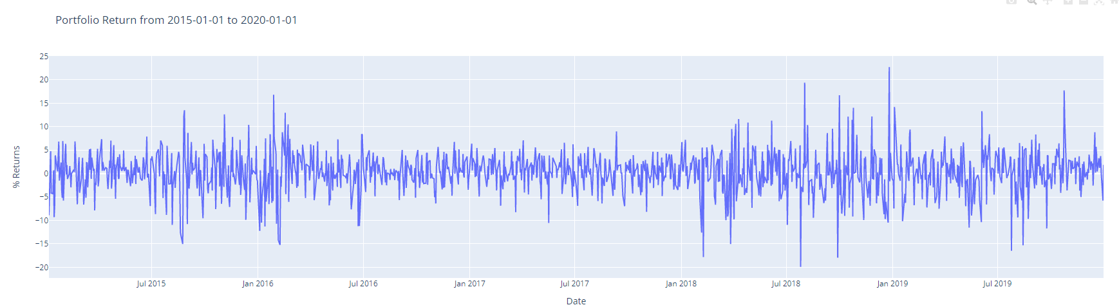
Portfolio % Returns

Slide 6
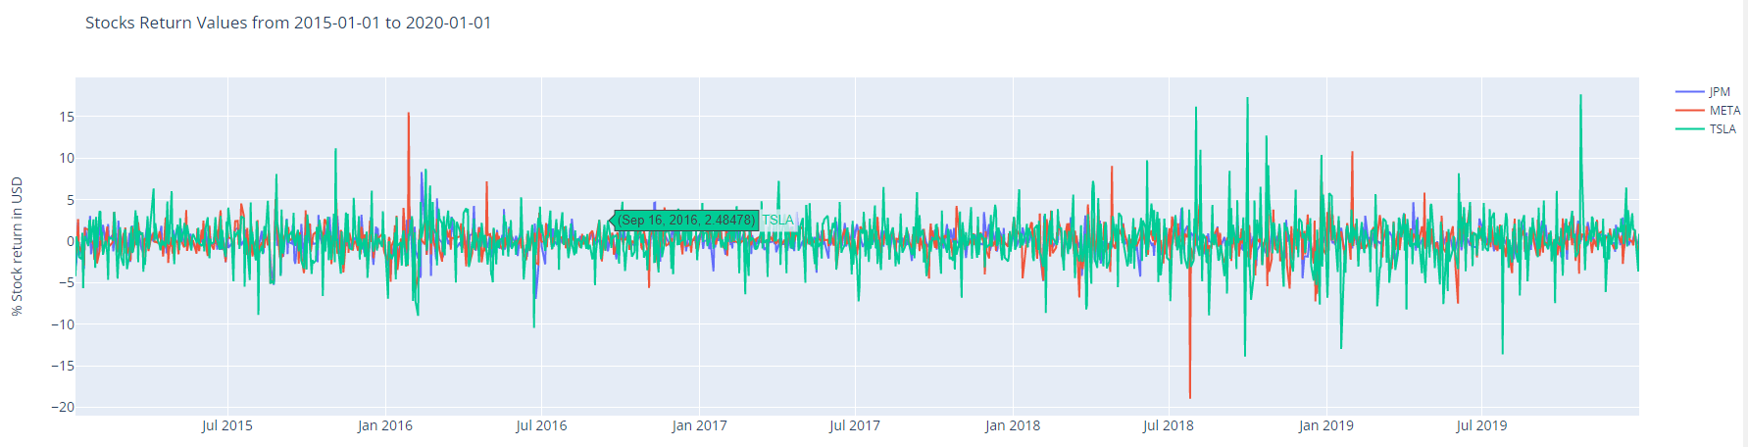
Stock Returns

Slide 7
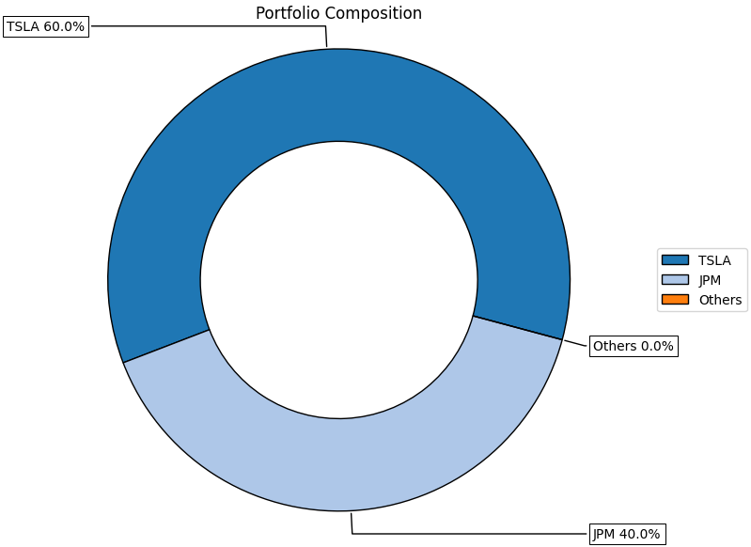
Portfolio Weight Composition

Slide 8
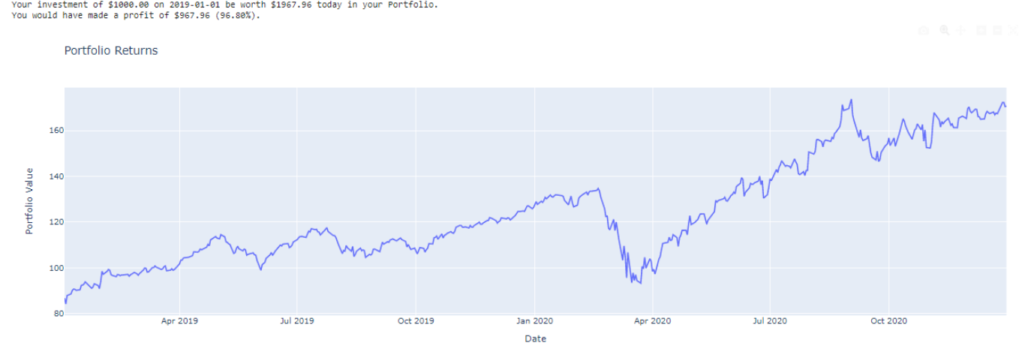
Portfolio: Gain/Loss

Slide 9
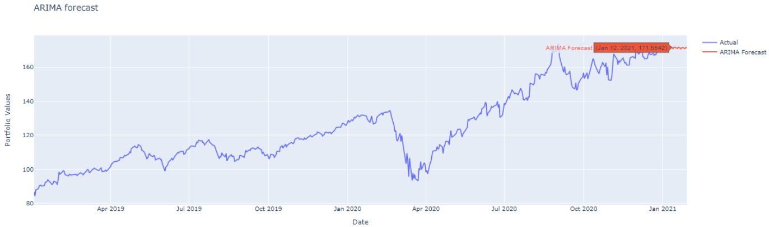

Model Implementation: ARIMA

Slide 10
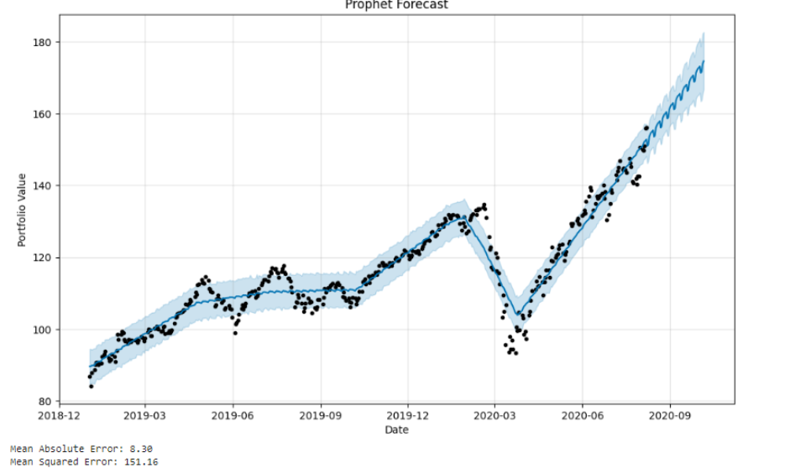
Model Implementation: FB Prophet

Slide 11
THANK YOU

